Slide 1
Functions of Combinational Circuits
Part 1
Course : CPEN6265010 Digital System
Effective Period : September 2025

Slide 2
Related LO
Learning Objectives
LO1: Analyze and Design Combinational Logic Circuits.

Slide 3
Outlines
Half and Full Adders
Parallel Binary Adders
Ripple Carry and Look-Ahead Carry Adders
Comparators
Decoders

Slide 4
Half and Full Adders
The half-adder accepts two binary digits on its inputs and produces two binary digits on its outputs (a sum bit and a carry bit).
The inputs and outputs can be summarized on a truth table.
The logic symbol and equivalent circuit are:
S
S
A
S
A
C_{out}
B
C_{out}
B

Slide 5


Half and Full Adders
By contrast, a full adder has three binary inputs (A, B, and Carry in) and two binary outputs (Carry out and Sum). The truth table summarizes the operation.
A full-adder can be constructed from two half adders as shown:
Σ
Σ
Σ
Σ
A
A
A
Sum
Σ
B
B
C_{out}
B
C_{out}
A
Σ
B
C_{out}
C_{in}
C_{in}
C_{out}
Symbol

Slide 6
Half and Full Adders
Σ
Σ
1
Σ
Σ
0
Sum
1
A
A
Example
B
0
1
0
C_{out}
B
C_{out}
For the given inputs, determine the intermediate and final outputs of the full adder.
1
C_{out}
1
Solution
The first half-adder has inputs of 1 and 0; therefore the Sum =1 and the Carry out = 0.
The second half-adder has inputs of 1 and 1; therefore the Sum = 0 and the Carry out = 1.
The OR gate has inputs of 1 and 0, therefore the final carry out = 1.

Slide 7
Half and Full Adders
Notice that the result from the previous example can be read directly on the truth table for a full adder.
Σ
Σ
1
Σ
Σ
0
Sum
1
A
A
B
0
1
0
C_{out}
B
C_{out}
1
C_{out}
1

Slide 8
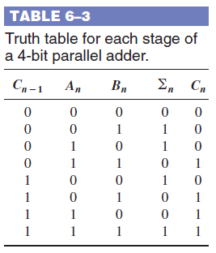
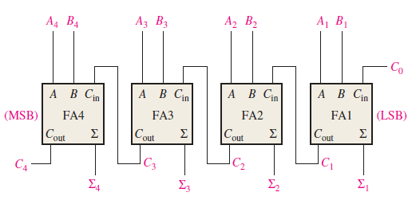
Parallel Binary Adders
Full adders are combined into parallel adders that can add binary numbers with multiple bits. A 4-bit adder is shown.
The output carry (C₄) is not ready until it propagates through all of the full adders. This is called ripple carry, delaying the addition process.

Slide 9
Parallel Binary Adders
The logic symbol for a 4-bit parallel adder is shown. This 4-bit adder includes a carry in (labeled (C₀) and a Carry out (labeled C₄).
Σ
1
2
3
4
1
2
3
4
Binary number A
4-bit sum
1
2
3
4
Binary number B
Input carry
C₀
C₄
Output carry
The 74LS283 is an example. It features look-ahead carry, which adds logic to minimize the output carry delay. For the 74LS283, the maximum delay to the output carry is 17 ns.

Slide 10
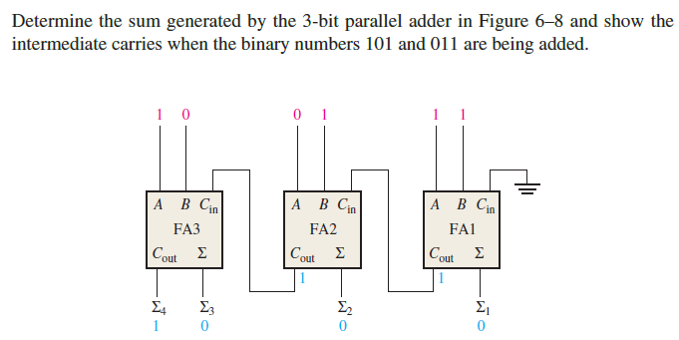
Parallel Binary Adders

Slide 11
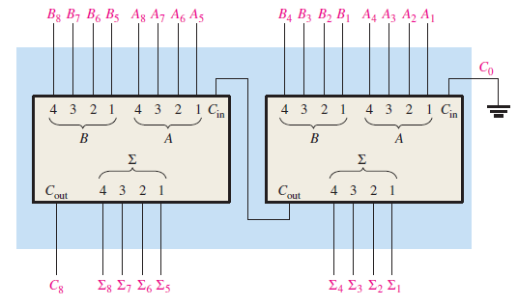
Parallel Binary Adders
The 4-bit parallel adder can be expanded to handle the addition of two 8-bit numbers by using two 4-bit adders. This process is known as cascading.

Slide 12
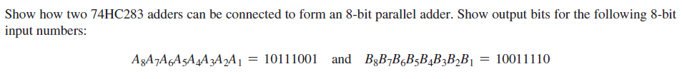
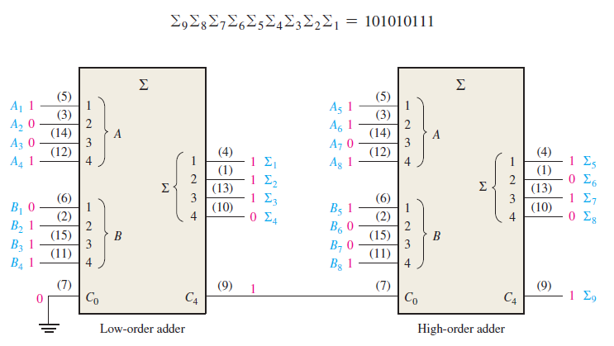
Parallel Binary Adders

Slide 13
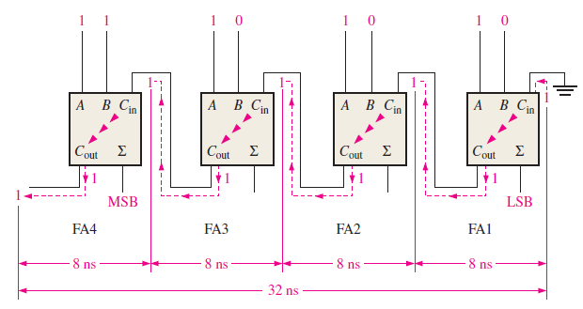
Ripple Carry and Look-Ahead Carry Adders
The carry propagation delay for each full-adder is the time from the application of the input carry until the output carry occurs.

Slide 14
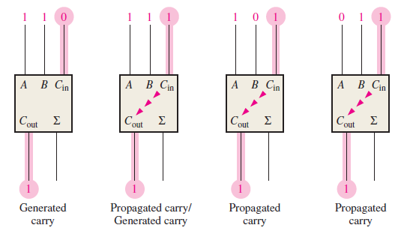


Ripple Carry and Look-Ahead Carry Adders
The look-ahead carry adder anticipates the output carry of each stage, and based on the inputs, produces the output carry by either carry generation (Cg) or carry propagation (Cp).
$$C_{g}=AB$$
$$C_{p}=A+B$$

Slide 15
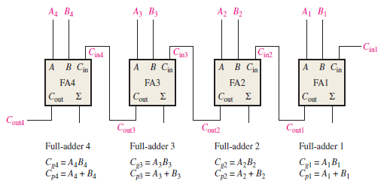

Ripple Carry and Look-Ahead Carry Adders
We get an output carry of 1 if it is generated by the full-adder (A = 1 AND B = 1) or if the adder propagates the input carry (A = 1 OR B = 1) AND Cin = 1.
$$C_{out}=C_{g}+C_{p}C_{in}$$

Slide 16
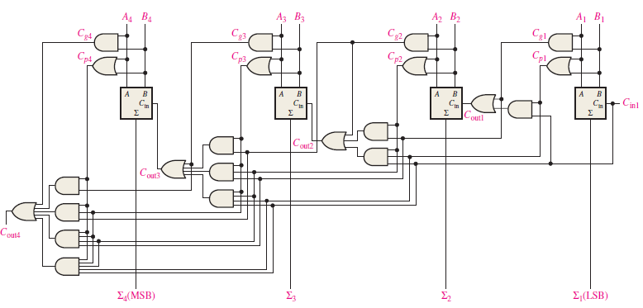
Ripple Carry and Look-Ahead Carry Adders

Slide 17
Comparators
The function of a comparator is to compare the magnitudes of two binary numbers to determine the relationship between them. In the simplest form, a comparator can test for equality using XNOR gates.
Example
How could you test two 4-bit numbers for equality?
Solution
AND the outputs of four XNOR gates.
XNOR
A₁
B₁
A₂
B₂
Output
0 0
0 1
1 0
1 1
1
0
0
1
A₃
B₃
A₄
B₄

Slide 18
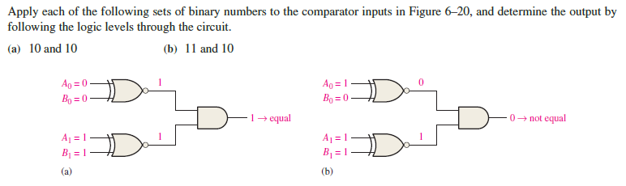
Comparators

Slide 19
Comparators
Two main types of digital comparator available :
1. Identity Comparator, is a digital comparator that has only one output terminal for A=B where the output will be HIGH when A=B=1 or LOW when A=B=0. Example IC : 74F521 (8-bit identity comparators).
2. Magnitude Comparator, is a digital comparator which has three output terminals, one each for equality (A=B), greater than (A>B), and less than (A<B). Example IC : 74LS85 (4-bit magnitude comparators).

Slide 20
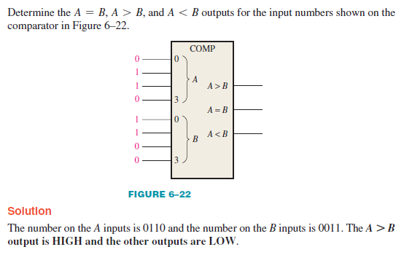
Comparators
The general procedure used in a comparator is to check for an inequality in a bit position, starting with the highest-order bits (MSBs).

Slide 21
Comparators
IC comparators provide outputs to indicate which of the numbers is larger or if they are equal. The bits are numbered starting at 0, rather than 1 as in the case of adders. Cascading inputs are provided to expand the comparator to larger numbers.
COMP
A₀
0
A₁
A
A₂
A₃
3
Cascading inputs
A > B
A > B
A = B
A = B
Outputs
A < B
A < B
B₀
0
B₁
A
The IC shown is the 4-bit 74LS85.
B₂
B₃
3

Slide 22
Comparators
IC comparators can be expanded using the cascading inputs as shown. The lowest order comparator has a HIGH on the A = B input.
LSBs
MSBs
A₀
COMP
A₄
COMP
A₁
0
A₅
0
A₂
A
A₆
A
A₃
A₇
3
3
A > B
A > B
A > B
A > B
+5.0 V
A = B
A = B
A = B
A = B
Outputs
B₀
A < B
A < B
B₄
A < B
A < B
0
0
B₁
A
B₅
A
B₂
B₆
B₃
3
B₇
3

Slide 23
Decoders
A decoder is a logic circuit that detects the presence of a specific combination of bits at its input. Two simple decoders that detect the presence of the binary code 0011 are shown. The first has an active HIGH output; the second has an active LOW output.
A₀
A₀
A₁
X
A₁
X
A₂
A₂
A₃
A₃
Active HIGH decoder for 0011
Active LOW decoder for 0011

Slide 24
Decoders
Question
Assume the output of the decoder shown is a logic 1. What are the inputs to the decoder?

Slide 25
Decoders
IC decoders have multiple outputs to decode any combination of inputs. For example the binary-to-decimal decoder shown here has 16 outputs – one for each combination of binary inputs.
For the input shown, what is the output?
Question

Slide 26
Decoders
X/Y
A specific integrated circuit decoder is the 74HC154 (shown as a 4-to-16 decoder). It includes two active LOW chip select lines which must be at the active level to enable the outputs. These lines can be used to expand the decoder to larger inputs.
A₀
A₁
A₂
A₃
CS₁
CS₂
EN
74HC154

Slide 27
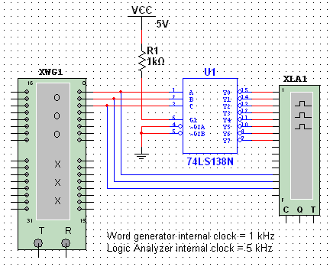
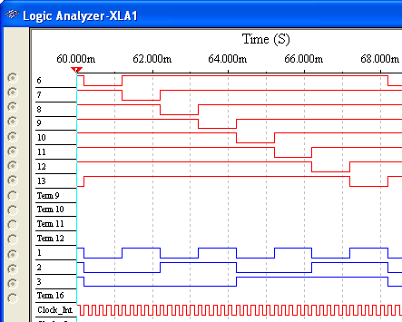
Decoders
The 74LS138 is a 3-to-8 decoder with three chip select inputs (two active LOW, one active HIGH). In this Multisim circuit, the word generator (XWG1) is set up as an up counter. The logic analyzer (XLA1) compares the input and outputs of the decoder.
Inputs are blue, outputs are red.

Slide 28
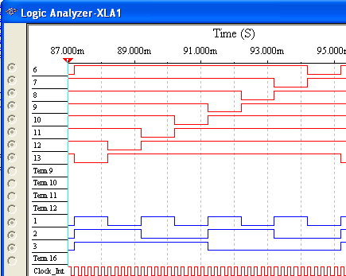
Decoders
Question
How will the waveforms change if the word generator is configured as a down counter instead of an up counter?
Inputs are blue, outputs are red.

Slide 29
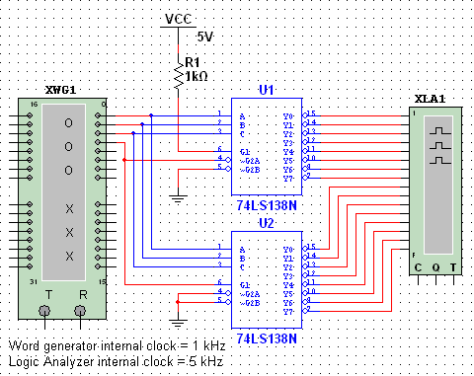
Decoders
The chip select inputs can be used to expand a decoder. In this circuit, two 74LS138s are configured as a 16 line decoder. Notice how the MSB is connected to one active LOW and one active HIGH chip select.
The next slide shows the logic analyzer output…

Slide 30
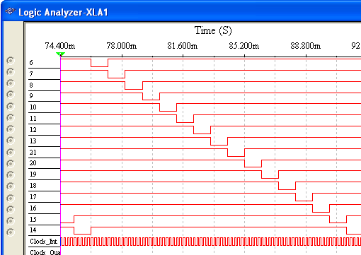
Decoders
Question
Is the word generator set as an up counter or a down counter? (The least significant decoder output at the top).
It is an up counter.

Slide 31
Decoders
BCD-to-decimal decoders accept a binary coded decimal input and activate one of ten possible decimal digit indications.
A₀
A₁
A₂
A₃
Example
Assume the inputs to the 74HC42 decoder are the sequence 0101, 0110, 0011, and 0010. Describe the output.
Solution
All lines are HIGH except for one active output, which is LOW. The active outputs are 5, 6, 3, and 2 in that order.

Slide 32
Decoders
Another useful decoder is the 74LS47. This is a BCD-to-seven segment display with active LOW outputs.
V_{CC}
The a-g outputs are designed for much higher current than most devices (hence the word driver in the name).
BCD/7-seg
BI/RBO
BI/RBO
BCD inputs
Outputs to seven segment device
LT
LT
RBI
RBI
74LS47
GND

Slide 33
Decoders
Here the 7447A is an connected to an LED seven segment display. Notice the current limiting resistors, required to prevent overdriving the LED display.

Slide 34
Decoders
The 74LS47 features leading zero suppression, which blanks unnecessary leading zeros but keeps significant zeros as illustrated here. The BI/RBO output is connected to the RBI input of the next decoder.
Blanked
Blanked
Depending on the display type, current limiting resistors may be required.

Slide 35
Decoders
Trailing zero suppression blanks unnecessary trailing zeros to the right of the decimal point as illustrated here. The RBI input is connected to the BI/RBO output of the following decoder.
Decimal point
Blanked
Blanked

Slide 36
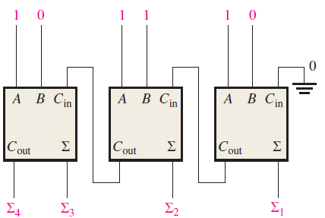
Exercise
What are the half-adder inputs that will produce the following outputs:
(a) Σ= 0, C_{out} = 0 (b) Σ = 1, C_{out} = 0 (c) Σ = 0, C_{out} = 1
For the parallel adder in next figure, determine the complete sum by analysis of the logical operation of the circuit. Verify your result by longhand addition of the two input numbers.

Slide 37
References
Null, Linda (2024). "The essentials of computer organization and architecture". 6th edition. Jones & Bartlett Learning, Burlington, Massachusetts. ISBN: 9781284259438..
Thomas L. Floyd. (2014). “Digital Fundamentals”. 11th Edition. Prentice Hall. New Jersey. ISBN: 978-0132737968.
Digital Combinational circuits: https://www.tutorialspoint.com/digital_circuits/digital_combinational_circuits.htm
Binary Adder: https://www.electronics-tutorials.ws/combination/comb_7.html

